Slide 1
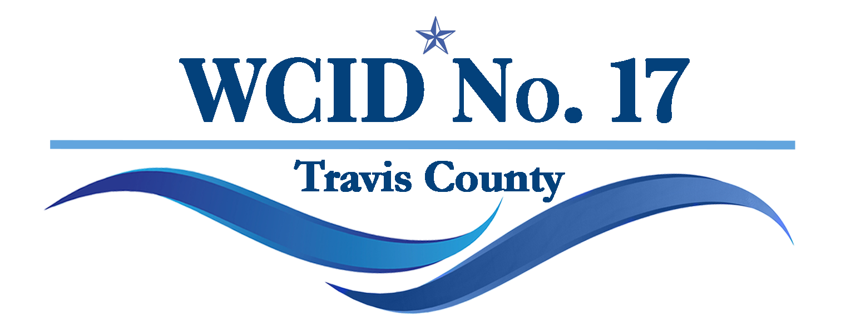
Apache Shores Service Area Waterline Replacement Issue:
46 Substandard water lines require replacement at an estimated cost of $73 Million.

Slide 2
Problem:
In 2023 District Staff and Engineers performed a water line assessment of all water lines served by our water systems. They were evaluated for the following:
  Material Condition (age of line, breakage history etc.)
  Number of homes that line services
  Whether or not the line can provide adequate fire flow
Based on these criteria, Apache Shores currently possesses 46 water lines that are graded by District Staff and Consultants as substandard.
The cost to replace these 46 water lines is estimated by our engineering consultants to be approximately $73 Million.
Final costs will not be available until June of 2026.

Slide 3
So how did we get here?
In 1997 the Apache Shores Utility Corporation was placed in receivership by the Texas Commission on Environmental Quality (TCEQ) due to substandard operations and inability to meet water quality safety standards.
At this time the AS POA approached WCID No. 17 and requested WCID No. 17 take over the Apache Shores Utility Corporation (ASUC) and run it to ensure water quality standards were maintained for the Apache Shores Community.
By not joining the District the community avoided having to pay District Taxes. This decision also resulted in the Apache Shores community maintaining financial responsibility for line maintenance and replacement.

Slide 4
How is the ODF money being spent?
Since 2011 the District has collected $1,848,000 from AS residents for water line replacements.
  In July 2011 the District completed the General Williamson waterline replacement for $1,400,000
  In May of 2017 the District completed the Platte Pass and Rainwater waterline replacement projects for $335,000
  In January of 2022 the District completed the Red Fox waterline project in the amount of $503,000
As of 9/30/2025, Apache Shores has approximately $1,800,000 set aside in capital reserves to pay for upcoming waterline replacements.

Slide 5
Advantages to joining the District as a defined area
Ability to be represented on the District Board of Directors.
  Have a voice in the future direction of the District and the services we provide to our customers.
Ability to complete the work in a timely fashion ~ 10 years and have the ODF go away.
  This will result in improved service
  Fewer community disruptions due to line breaks
  Improved roads as disturbed roads will be restored following construction per County standards
    POA may be able to transfer some roads to the County
  Potential improvements to home insurance rates
  FIRE PROTECTION as quickly as possible
Transferring long-term financial responsibility for line upkeep to WCID No. 17.

Slide 6
So why would I want to pay taxes instead of paying the Out of District fee?
Out of District Fee will not go away once the work is completed:
  Based on cost estimates of future line repairs a permanent ODF of approximately $250/month would be required to required to maintain the Apache Shores water lines.
Out of District Fee will require the majority of home owners to pay more than if they paid a Defined Area Tax.
Defined Area Tax Rates will go away when the bonds are paid off.
By joining the District as a Defined Area:
  The District will take on the long-term costs for all waterline improvements and maintenance in Apache Shores.
  Apache Shores will be eligible to elect District Board members, giving the community a voice in District policy and decisions.

Slide 7
What am I committing to by signing the petition?
If you chose to sign the petition you are simply agreeing to hold an election on whether Apache Shores should join the District.
That is it.

Slide 8
Why do we have to figure this out now?
The longer we wait to determine the path forward the more expensive these projects become and the higher the ODF or Tax Rate will be.
Delaying is a big part of how we all collectively have gotten into this mess in the first place.
Regardless of is Apache Shores choses to join the District or not, we will always do our best to ensure the work gets done correctly and in a cost-effective manner as possible,
  But delaying further only hurts the community.

Slide 9
Community Questions:
Q: You are only trying to get us to join the District to make money off from us.
A: This couldn’t be further from the truth.
  Asking Apache Shores to join the District is a time consuming and expensive proposition. It would be easier to simply set an ODF rate at a level that raises the necessary funds and conduct the work with or without Apache Shores input.
  But having you in District where you can take advantage of being District residents and have a choice in the long-term direction of the District is, I believe, the correct answer.

Slide 10
Community Questions:
Q: Joining the District may stop exploration of other options.
A: False. Nor is there any evidence to support this belief.
  Just recently the District obtained a $100,000 grant from the LCRA for an upcoming wastewater project in one of our service areas.
  Every year we review our upcoming projects and assess what funding paths are available to them. We review and apply for all possible grants that we qualify for.
  We will do the same for the Apache Shores area regardless of if you join the District or not.

Slide 11
Community Questions:
Q: Joining the District would result in millions of dollars of debt and incur large amounts of interest on that debt which would require repayment through additional taxes on all property in Apache Shores.
A: False.
  The millions of overdue and necessary expenses already exist because of the condition of the waterlines.
  The question is how Apache Shores will choose to fund the necessary repairs.
    Via an Out of District fee: which will cost more for 70% of property owners and residents.
      By not joining the District this fee would continue long-term even after this initial work is completed so that funding exist for the upkeep and future replacement of all lines in Apache Shores.
    Via a Defined Area Tax Rate: which is capped by law, and which would ensure that 70% of Apache residents pay the least amount possible to execute the work while avoiding future upkeep costs.

Slide 12
Questions?

